Slide 1
Ключевые аспекты оценки инвестиционных проектов топливно-энергетического комплекса в условиях индустрии 4.0
К.э.н., доцент И.В. Сокольникова
Магистрант Ларькова Е.

Slide 2
Тренды
The economy of the European Union is going to shift gradually from the commonly used hydrocarbons (like oil and gas) towards “green” energy.
Thelatest news from the EU states that financial help that is aimed for overcoming COVID-19 aftermaths includes the implementation of green projects in every European country.
Both European And USA governments have the aim to decrease the consumption of oil, coal and nuclear energy by 2030 and give up all these sources of energy by 2050.

Slide 3
Россия
The Russian renewable energy development association, a non-profit organization that represents RES sector on the Russian market with the aim to stimulate investments in the field of renewable sources of energy and to promote its use in the country in the foreseeable future.
The given association represents the fields of solar, wind and water sources of energy.

Slide 4
Green Projects
Examples
BP and Brazilian Bunge (bioenergy and sugarcane ethanol businesses) formed a joint-venture that is called BP Bunge Bioenergia. The new company has a production capacity of 32 million metric tones of sugarcane per year.
Moreover, BP managed to increase its share in Lightsource BP that is going to produce 10GW of solar energy by 2023.
One more interesting project where BP participates too is the production of bio-isobutanol from corn that is widely used as paints and lubricants.
All the above mentioned projects have one common thing in their core: BP wants to develop and to bring to our everyday life digital platforms that make it much easier for every person to be connected to low carbon electricity for powering their homes and cars.

Slide 5
Green Projects in Russia
Russian state corporation, Rosatom, has already started to implement “green” projects connected with windmills since 2018. The company entered the wind energy market successfully. According to preliminary estimations, the company will be able to generate 3.6 GW by 2024 that will help to reach the annual turnover at the amount of US 1,6 billion. This amount will guarantee the demand for production of windmills, wind turbines and the rest of wind farms, required infrastructure together with support services.

Slide 6
Green projects evaluation
Traditional methodology
Real option valuation

Slide 7
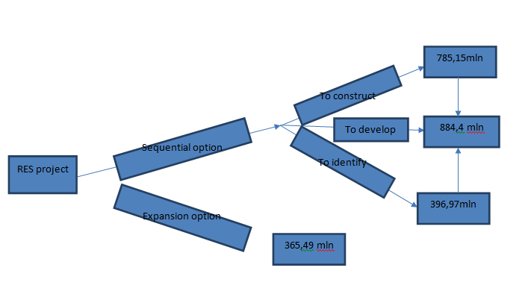
Real option valaution

Slide 8
Thank you for your attention

