Slide 1
SDG7 and SDG13:
Possible ways of interactions
Alexander M. Solntsev, Peoples' Friendship University of Russia, Moscow, Russia
Roza D. Akshalova, L.N. Gumilyov Eurasian national university, Nur-Sultan, Kazakhstan

Slide 2
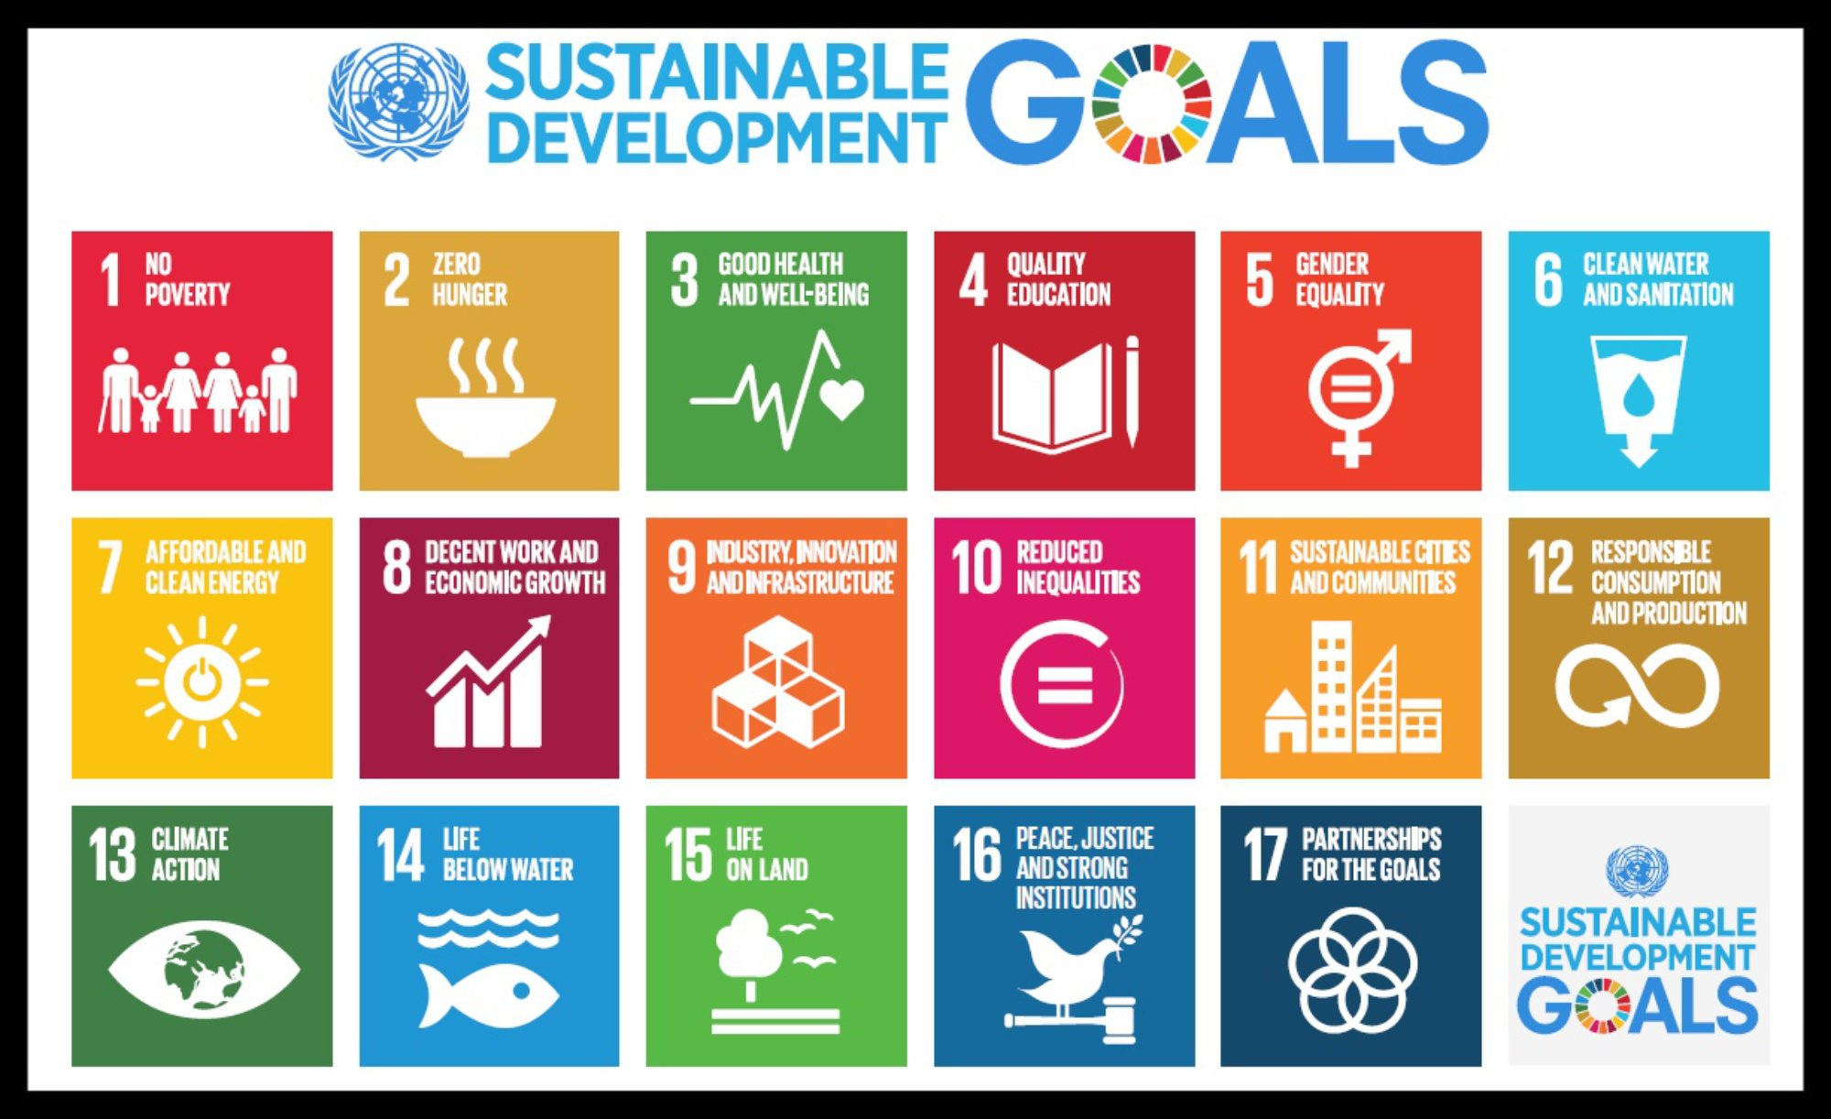
тренды
1

Slide 3
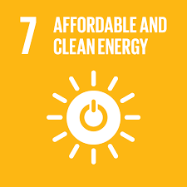
7.1 By 2030, ensure universal access to affordable, reliable and modern energy services
7.2 By 2030, increase substantially the share of renewable energy in the global energy mix
7.3 By 2030, double the global rate of improvement in energy efficiency
7.a By 2030, enhance international cooperation to facilitate access to clean energy research and technology, including renewable energy, energy efficiency and advanced and cleaner fossil-fuel technology, and promote investment in energy infrastructure and clean energy technology
7.b By 2030, expand infrastructure and upgrade technology for supplying modern and sustainable energy services for all in developing countries, in particular least developed countries, small island developing States and landlocked developing
countries, in accordance with their respective programmes of support
13.1 Strengthen resilience and adaptive capacity to climate-related hazards and natural disasters in all countries
13.2 Integrate climate change measures into national policies, strategies and planning
13.3 Improve education, awareness-raising and human and institutional capacity on climate change mitigation, adaptation, impact reduction and early warning
13.a Implement the commitment undertaken by developed-country parties to the United Nations Framework Convention on Climate Change to a goal of mobilizing jointly $100 billion annually by 2020 from all sources to address the needs of developing countries in the context of meaningful mitigation actions and transparency on implementation and fully operationalize the Green Climate Fund through its capitalization as soon as possible
13.b Promote mechanisms for raising capacity for effective climate change-related planning and management in least developed countries and small island developing States, including focusing on women, youth and local and marginalized communities

Slide 4
Methodology
nationally determined contributions (NDC), which should be prepared in the framework of the Paris Agreement on Climate Change 2015
Green Climate Fund
World Intellectual Property Organization (WIPO)
Annual United Nations Sustainable Development Goals Report (UN Secretary General)
World Trade Organization (WTO) Dispute Settlement Body

Slide 5
trends
Sustainable Development Goal 7 «Ensure access to affordable, reliable, sustainable and modern energy for all»
Sustainable Development Goal 13 “Take urgent action to combat climate change and its impacts”. .
double the agricultural productivity and ensure sustainable food production systems (Sustainable Development Goal 2),
equipping hospitals with electricity and spare power generators, even in remote parts of the earth, access to modern energy can significantly support the functioning of health clinics in rural areas (Sustainable Development Goal 3),
equipping preschool, secondary, secondary special and higher educational institutions with electricity for the improvement the quality and availability of educational services and increasing the likelihood that children will attend and complete schooling (Sustainable Development Goal 4),
However, renewable energy sources play more significant role in reducing greenhouse-gas emissions and thus mitigating the effects of climate change
“The interlinkages and integrated nature of the Sustainable Development Goals are of crucial importance in ensuring that the purpose of the crucial importance in ensuring that the purpose of the new Agenda is realized”

Slide 6
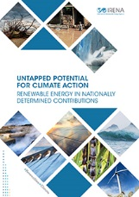
the nationally determined contributions, which should be prepared in the framework of the Paris Agreement on Climate Change 2015
International Renewable Energy Agency has undertaken an analysis of current nationally determined contributions:
1) Of the 152 nationally determined contributions that were formally submitted to date,
some 111 (or nearly three quarters) cite specific renewable energy targets,
while another 34 acknowledge renewables as an important way to reduce GHG emissions and adapt to climate change impacts
2) the majority of nationally determined contributions include renewable
energy targets only for electricity generation.
14 countries also include targets for the production of liquid biofuels,
11 states call for advancement of biogas,
8 states include the deployment of solar water heaters

Slide 7
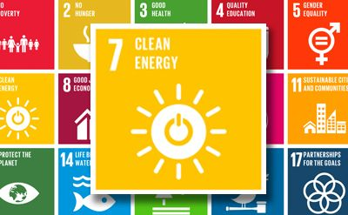
The United Nations Secretary-General António Guterres has proposed six climate-positive actions for governments to shape the recovery, some of which relate to Sustainable Development Goal 7 implementation:
- green transition from fossil fuels,
- green economy,
- green jobs (The global renewable energy sector employed 11 million people)
- sustainable growth,
- invest in sustainable solutions (In 2017, international
government investments to developing countries in order
to spread renewable energy rose to $ 21.4 billion)

Slide 8
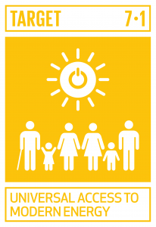
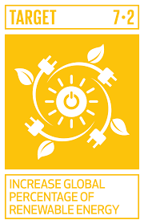
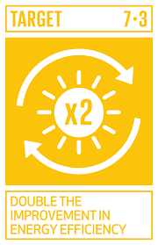
Green Climate Fund
Full functioning of the Green Climate Fund and its assistance to developing countries to mitigate or combat climate change
contribute to the financing of renewable energy projects, especially solar, geothermal and hydropower (Sustainable Development Goal 7.1 and 7.2), the transition to sustainable energy (Sustainable Development Goal 7.1), energy efficiency (Sustainable Development Goal 7.3), investment in renewable energy programs (Sustainable Development Goal 7.a) in selected regions and countries (Sustainable Development Goal 7.b)

Slide 9
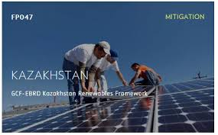
The Green Climate Fund
The Green Climate Fund is governed by a Board consisting of 24 members of developing and developed country Parties, and is accountable to and functions under the COP, to support adaptation and mitigation climate projects, including renewable energy projects. RE projects form a significant portion of the mitigation activities the Fund is financing.
The Green Climate Fund and European Bank for Reconstruction and Development provided funding project Kazakhstan Renewable Framework in October 2017 for a period of five years for supporting the construction of 8-11 renewable energy projects in Kazakhstan with a total capacity of 330 MW.

Slide 10
The promotion and facilitation of environmentally sound technologies regulates by Article 4.5 of UNFCCC 1992.
2007 the Bali Action Plan
Climate change mitigation technologies include different groups of technologies divided by area of application. One of them is group of energy supply, that consist of “the most prominent being wind, geothermal, concentrated solar energy, biomass/biogas and hydrogen systems”
According to World Intellectual Property Organization Global Challenges Report, key areas for climate change mitigation technology are biofuels, solar thermal energy, solar photovoltaic energy, wind energy

Slide 11
Renewable energy technologies

Slide 12
United Nations Sustainable Development Goals Report 2020
“the share of renewable energy in total final energy consumption reached 17.3 per cent in 2017, up from 17.0 per cent in 2015 and 16.3 per cent in 2010. This growth was driven primarily by increased consumption of modern renewables, which rose from 8.6 per cent in 2010 to 10.5 per cent in 2017”
The practical implementation of the Sustainable Development Goals raises questions that can delay and complicate the process of achieving them. “The COVID-19 pandemic is highlighting the urgent need for affordable and reliable energy – for hospital and health facilities to treat patients, for communities to pump clean water and access vital information and for out-of-school children to learn remotely. At the same time, the crisis is certain to stymie efforts towards Goal 7. Disruptions in supply chains could wreak havoc on energy services, and declined incomes could limit people’s ability to pay for them. Besides, deterring oil prices are likely to discourage growth in renewables”

Slide 13
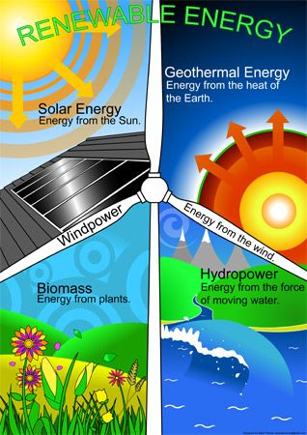
Government subsidies for Renewable energy sources have become one of the subjects of trade disputes of the World Trade Organization Dispute Settlement Body:
1) DS412 “Canada – Certain Measures affecting the renewable energy generation sector’ dated September 13, 2010 (WTO, 2010a);
2) DS419 “China — Measures concerning wind power equipment” dated December 22, 2010 (WTO, 2010b);
3) DS426 “Canada — Measures related to the Feed-in Tariff Program” dated August 11, 2011 (WTO, 2011);
4) DS437 “United States — Countervailing duty measures on certain products from China” dated May 25, 2012 (WTO, 2012a);
5) DS452 “European Union and certain Member States — Certain measures affecting the renewable energy generation sector” dated November 5, 2012 (WTO, 2012b);
6) DS456 “India — Certain measures relating to solar cells and solar modules” dated February 6, 2013 года (WTO, 2013);
7) DS510 “United States — Certain measures relating to the renewable energy sector” dated September 9, 2016 (WTO, 2016);
8) DS563 United States — Certain measures relating to the renewable energy sector dated August 14, 2018 (WTO, 2018).

Slide 14
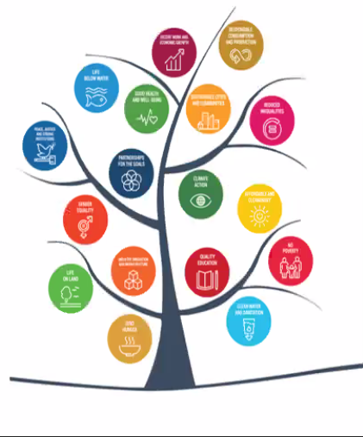
Conclusion
On the basis of the above, we conclude that ways of interaction of SDG 7 and SDG 13 are very different and interdependent from each other. The achievement these SDGs needs the same actions of state, and results of these activity will lead to successful implementation of 2030 Agenda and Paris Agreement on Climate Change 2015. A strong contractual and institutional framework has been created for this interaction, which operates not only within the framework of the above mechanisms, but also takes place within the framework of the Energy Charter Treaty, International Renewable Energy Agency, International Energy Agency, World Bank, World Intellectual Property Organization. We believe that this framework will serve as an excellent coherent framework for achieving the 2030 Agenda.

Slide 15
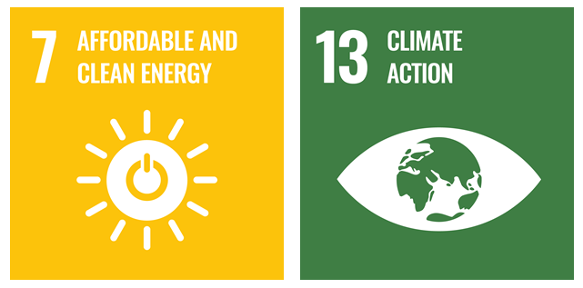
Thank you for attention!

