Slide 1
HEIs network collaboration on water resources for fostering innovative educational methods
Komagaeva Julia, World Bank;
Kovaleva Marina, Hamburg University of Applied Sciences;
Nagornov Vitaly, MGIMO

Slide 2
Cross-regional HEIs collaboration is becoming most efficient with the use of online educational methods and interactive tools.
The education has a significant role in the facilitation of national and regional dialogue as well as cooperation on water resources issues, some of which are of transboundary nature.

Slide 3
Research focus - HEIs in Central Asia and Eastern Europe
Methodology
Quantitative data
Qualitative data
Recommendations
Concept
45 educational programs on water resources and related areas at Russian universities
4 selected universities, Belgrade University in Serbia, Brest State Technical University in Belarus, Kazakh-German University in Kazakhstan, and Kyrgyz National Agrarian University after K.I. Scriabin in Kyrgyzstan. 4 countries are members of the Aarhus Centres network.
The network collaboration for promoting innovative educational methods at HEIs in Central Asia.
The analysis of the educational programs sample helps to identify the main characteristics of an “innovative approach in education”. The concept of the “innovative approach in education” considers new and non-widespread educational methods.

Slide 4
Cross-regional HEIs collaboration is becoming most efficient
with the use of online educational methods and interactive tools.
Communication
Innovations
Cooperation
Professionalization
The Academic Information and Communication Network in Russia, implemented under the auspices of Tempus, enabled many universities to try serving as network nodes to address the lack of knowledge on water resources.
The innovative educational approach demonstrates effectiveness when it is integrated into a program on water resources. Instead of a standardized lesson, teachers switch to laboratory observations and experimental work.
OECD proposes to promote education and various trainings for water experts to enhance the capacities of water institutions and organisations, and decision-makers to foster cross-border cooperation
The qualitative difference in water resources programs assumes availability of short practical distance courses on introducing effective and innovative methods, courses for decision-makers and stakeholders, training courses on expanding the service sector for independent experts, and courses for teachers.

Slide 5
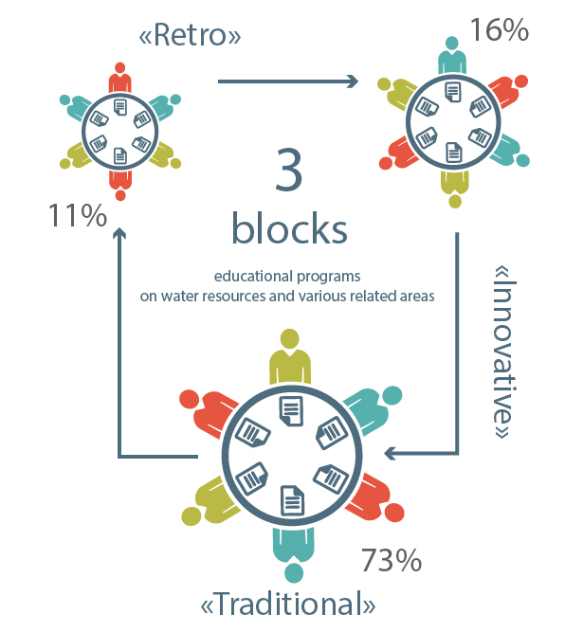
Results and discussion
The educational programs on water resources and related areas at Russian universities could be formally split into three blocks
The first block consists of programs that are based on the concepts established during the times of the USSR. The share of this block is not large (11%), but it sufficiently illustrates the lack of flexibility in developing the curriculum.
The second block is focused on compliance with the standards adopted by the Ministry of Education and Science, assumes a unified approach to naming programs related to water resources. This blog is the largest one (73%), but quantitative measurement does not suggest introducing additional subjects and new training technologies. Programs titled ‘Environmental Engineering and Water’ comprise more than half the sample.
The third block includes various modifications of standard educational programs (16%), which can imply an innovative educational approach, at least in this quantitative context. The third clustered block is considered as innovative.

Slide 6
Conclusions and recommendations
Central Asian HEIs are looking for networking cooperation
The review of existing programs of higher educational institutions and networks has identified advantages for promoting innovative educational approaches in the area of water resources, and highlighted the need for transboundary cooperation through establishment of regional networks with higher educational institutions as members.
Based on the assessment of the existing network approach in water resources education and of emerging needs for the transition to online communication formats, the proposed solution for higher education institutions could be based on (1) the creation of sectorial professional networks and online platforms; (2) the possibility to create unified learning curricula that could be accepted by members of a HEIs network.
Networking fosters cross-collaboration of HEIs, minimizes costs, creates a solid base for efficient regional cooperation and dialogue on regional water resource issues. As an integrated study discipline, water education has to meet high-quality standards, use new educational mechanisms and enhance opportunities for regional cooperation.

Slide 7
Thank you!
v.nagornov@my.mgimo.ru
jkomagaeva@worldbank.org
marina.kovaleva@haw-hamburg.de

